Slide 1
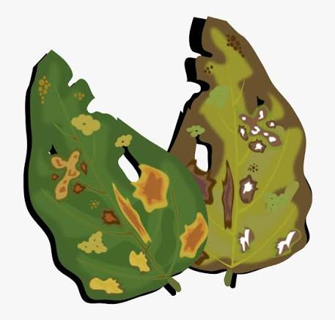
Rice Leaf Disease Detection Using Convolutional Neural Networks (CNN) Data Science Capstone Project – PRCP-1001 Submitted By: Sameeksha

Slide 2
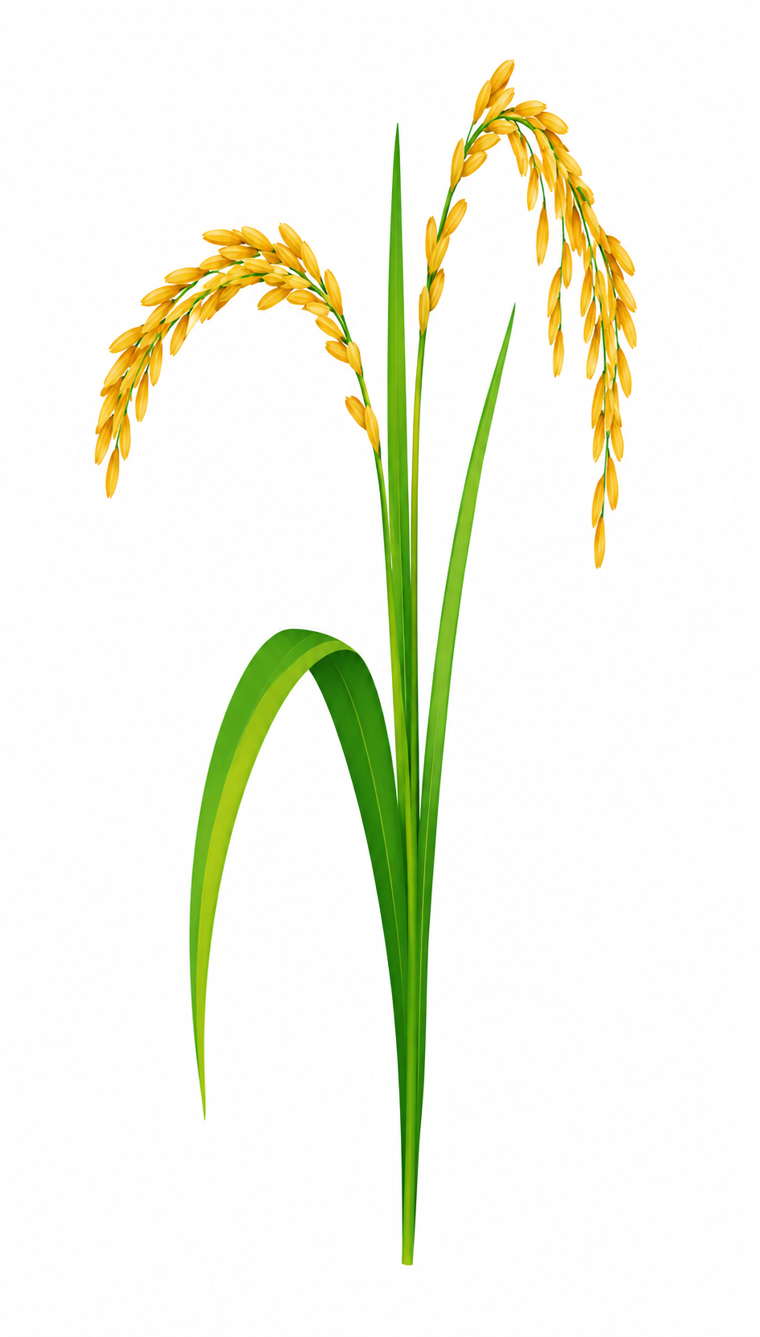
TABLE OF CONTENTS
Problem Statement
Dataset Overview
Disease Categories
Project Workflow
Exploratory Data Analysis (EDA)
Image Preprocessing
Train–Validation–Test Split
Data Augmentation
Deep Learning Models (CNN, VGG16 & MobileNetV2)
CNN Architecture
11. Transfer Learning
12. Challenges Faced
13. Model Comparison
14. Best Model Selection
15. Applications
16. Future Scope
17. Conclusion
18. Model Output & Predictions

Slide 3

1. PROBLEM STATEMENT
1.Problem Statement
Rice is one of the world's most important food crops. Diseases affecting rice leaves reduce crop yield and quality, causing significant economic losses.
Traditional disease identification is:
Time-consuming
Dependent on agricultural experts
Prone to human error
2.Project Goal - Develop an AI-based image classification system using Convolutional Neural Networks (CNN) to automatically detect rice leaf diseases from leaf image
3.Objectives
Analyze the rice leaf disease dataset
Build deep learning classification models
Apply image augmentation techniques
Compare multiple CNN models
Select the best-performing model

Slide 4
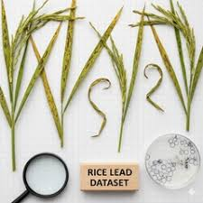
2. DATASET OVERVIEW
1. Dataset Information
Total Images: 120
Disease Classes: 3
Images per Class: 40
Dataset Type: Balanced
3. Dataset Characteristics
RGB leaf images
Different image resolutions
No corrupted images
Balanced class distribution
2. Disease Categories
Bacterial Leaf Blight
Brown Spot
Leaf Smut
4.Challenge
Small dataset size increases the risk of model overfitting
5. Dataset Link: https://d3ilbtxij3aepc.cloudfront.net/projects/CDS-Capstone-Projects/PRCP-1001-RiceLeaf.zip

Slide 5
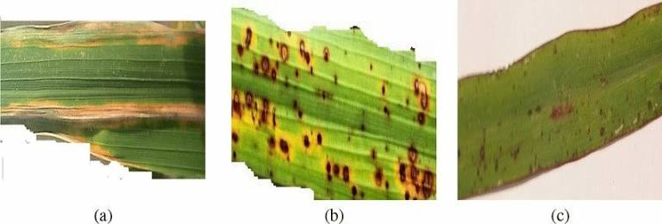
3. DISEASE CLASSES
Rice Leaf Disease Classes
1.Bacterial Leaf Blight
Long yellow or pale streaks
Spread along leaf veins
2.Brown Spot
Small circular brown lesions
Dark edges with lighter centers
3.Leaf Smut
Tiny black speckled spots
Dense fungal infection on leaf surface

Slide 6
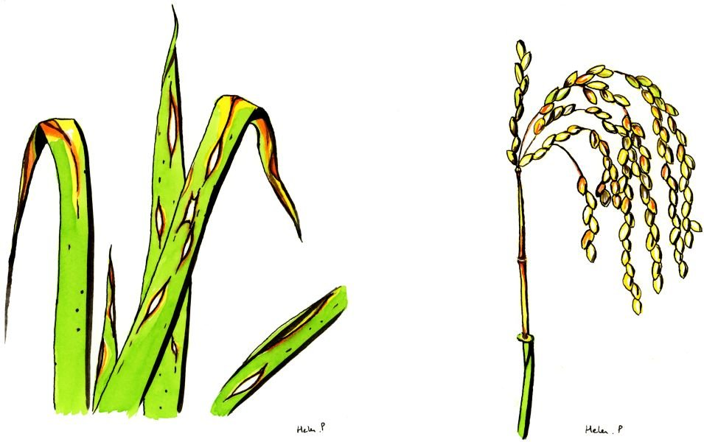
4. PROJECT WORKFLOW
Project Pipeline
Collect Dataset
Data Exploration (EDA)
Image Preprocessing
Train–Validation–Test Split
Data Augmentation
Build CNN Models
Train Models
Validate Models
Test Models
Compare Models
Select Best Model
Predict Rice Leaf Disease

Slide 7
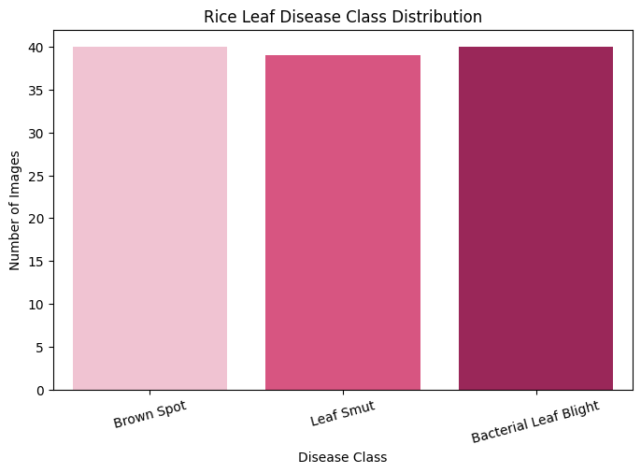
5. EXPLORATORY DATA ANALYSIS (EDA)
1.Dataset Analysis
Performed detailed dataset analysis before model training.
2.Analysis Performed
Class distribution
Image count
Image dimensions
RGB image verification
Sample image visualization
Corrupted image detection
3.Findings
Balanced dataset
No missing images
Images required resizing
Disease classes visually distinguishable

Slide 8
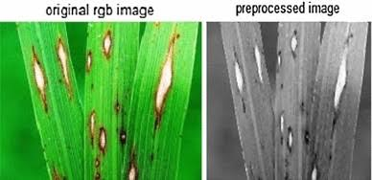
6. IMAGE PREPROCESSING
1.Image Preprocessing Steps
Extract nested ZIP files
Organize images into class folders
Resize all images to 224 × 224
Convert images into RGB format
Normalize pixel values between 0 and 1
Prepare images for CNN input
2.Purpose-To create a clean and standardized dataset for model training.

Slide 9
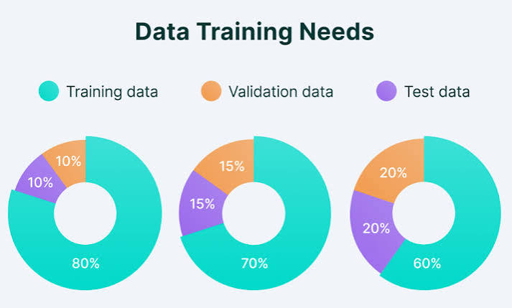
7. TRAIN–VALIDATION–TEST SPLIT
1.Dataset Splitting
Training Set: 70%
Validation Set: 15%
Test Set: 15%
2.Why Split the Dataset?
Training: Learn image patterns
Validation: Tune model performance
Testing: Evaluate final accuracy

Slide 10
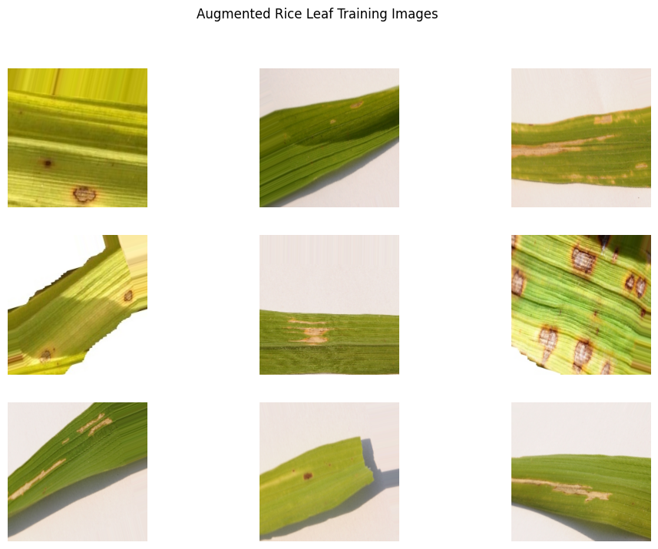
8. DATA AUGMENTATION
1.Why Data Augmentation?
Only around 84 training images were available.
Augmentation increases image diversity and reduces overfitting.
2.Techniques Used
Rotation
Width Shift
Height Shift
Shear
Zoom
Horizontal Flip
Rescaling
3.Not Used- Vertical Flip (unrealistic leaf orientation)

Slide 11
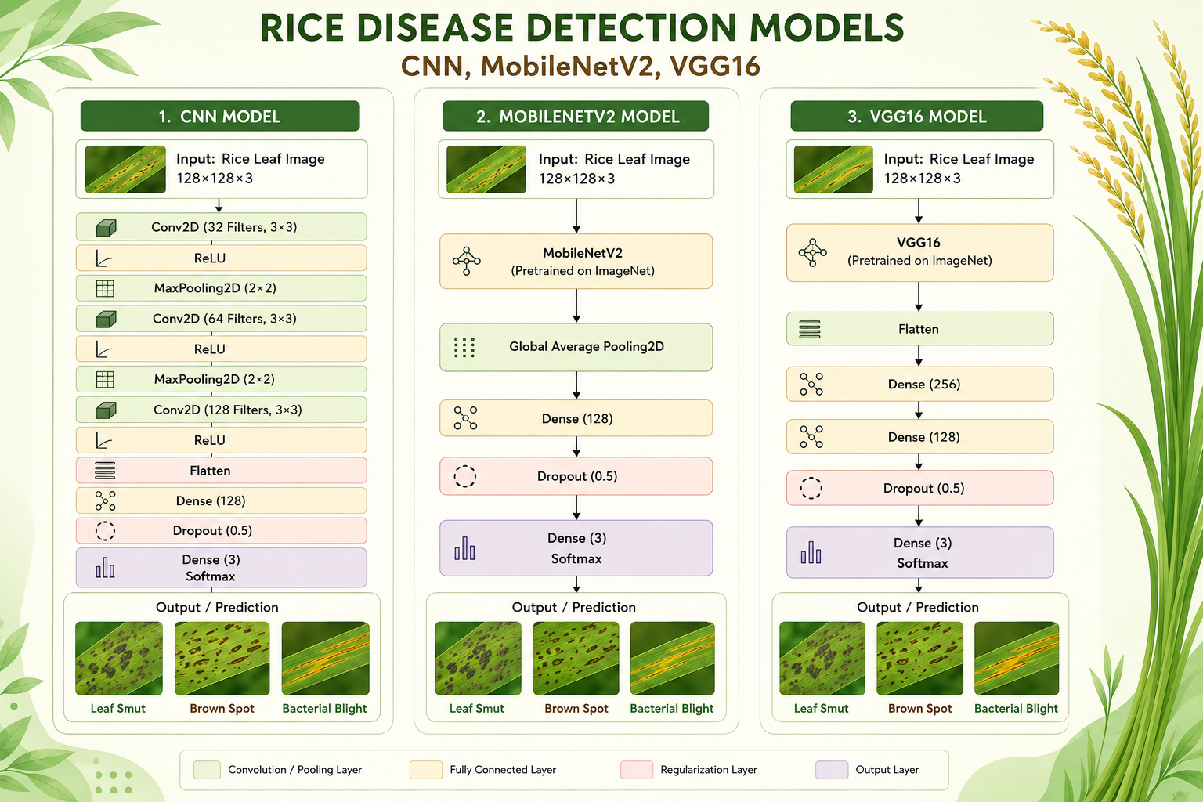
9. MODELS USED
Three Deep Learning Models
1.Model 1 – CNN
Built from scratch
Benchmark model
Learns features directly from training images
2.Model 2 – VGG16
Transfer Learning
Pretrained on ImageNet
High accuracy
Large model size
3.Model 3 – MobileNetV2
Transfer Learning
Lightweight architecture
Fast prediction
Suitable for mobile devices

Slide 12
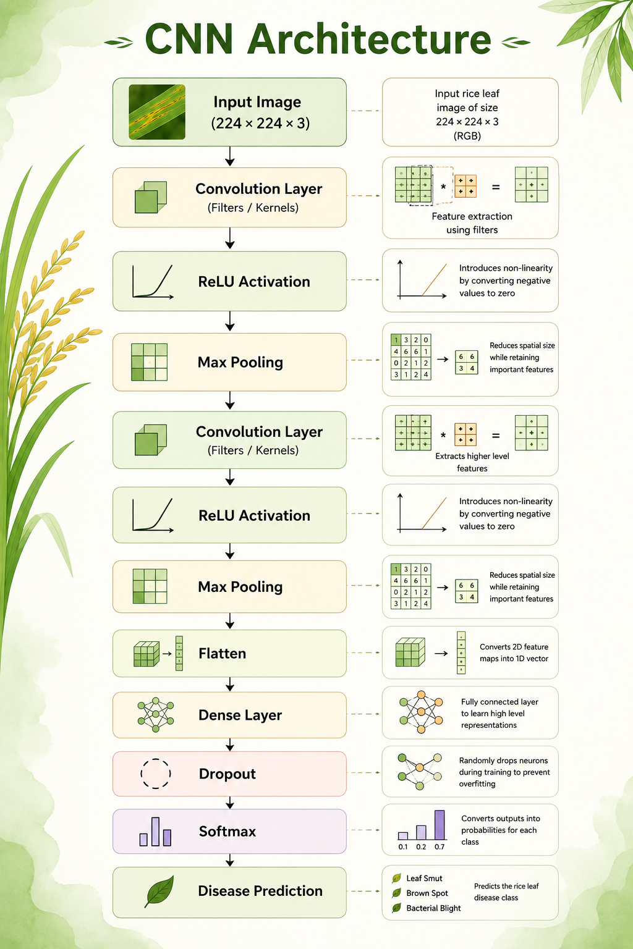
10. CNN ARCHITECTURE

Slide 13
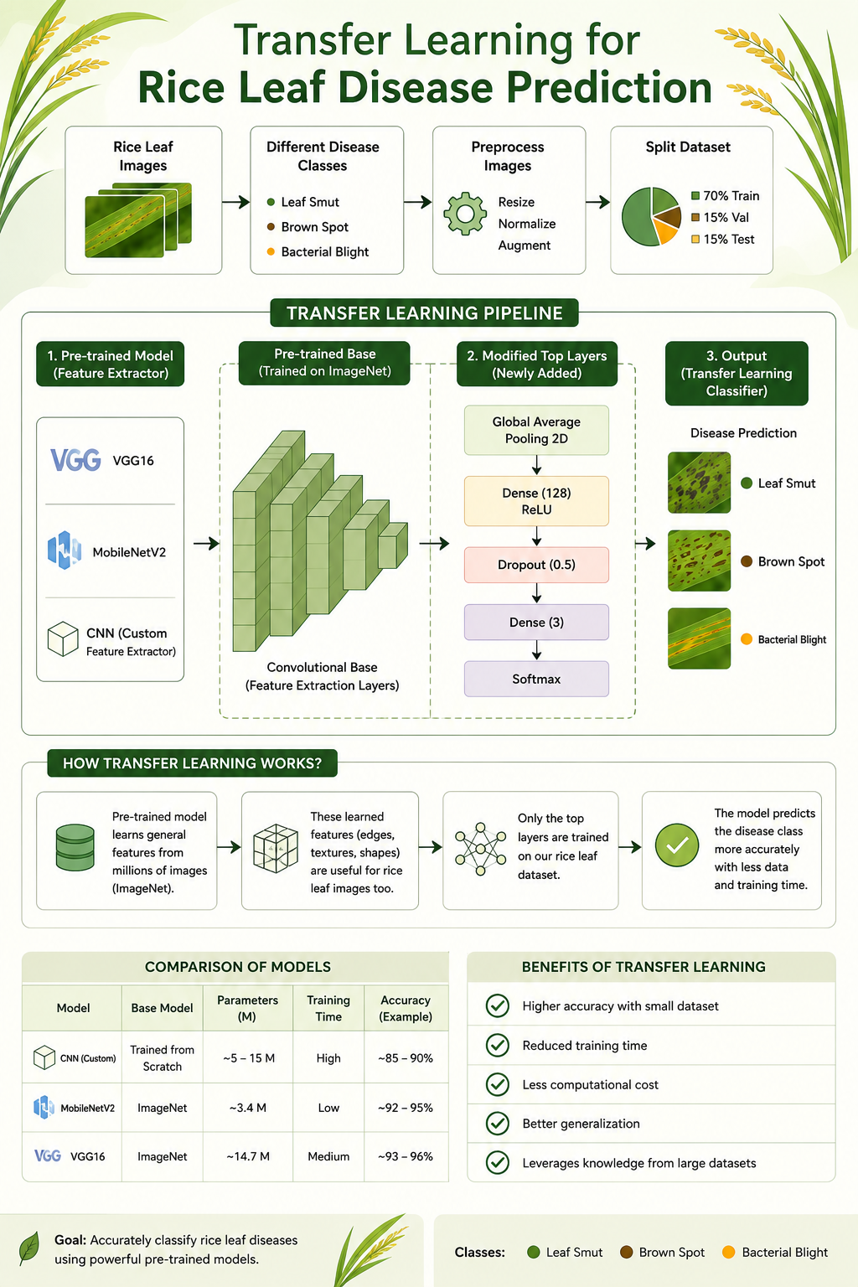
11. TRANSFER LEARNING
1.Why Transfer Learning?
The dataset contained only 120 images, making it difficult to
train deep CNNs from scratch.
Transfer learning uses pretrained ImageNet models to improve performance.
2.Benefits
Faster training
Better feature extraction
Higher accuracy
Reduced overfitting
Models Used
VGG16
MobileNetV2

Slide 14
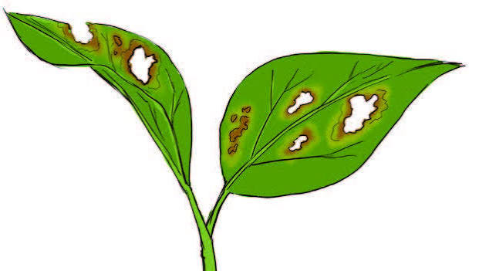
12. CHALLENGES FACED
1. Challenges
Small dataset
Different image resolutions
Nested ZIP folder structure
Similar disease patterns
Label mismatch during prediction
Limited computing resources
Risk of overfitting
2. Solutions
Data augmentation
Transfer learning
Proper preprocessing
Dynamic class mapping
Standardized dataset split

Slide 15
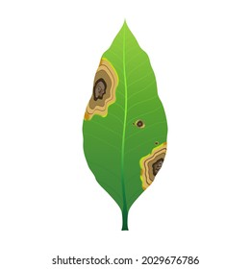
13. MODEL COMPARISON
MODEL | ADVANTAGE | LIMITATION
CNN | Simple architecture | Overfitting, lower accuracy
VGG16 | Accuracy | Large model, slower inference
MobileNetV2 | Lightweight, fast, accurate | Slightly lower complexity than VGG16

Slide 16
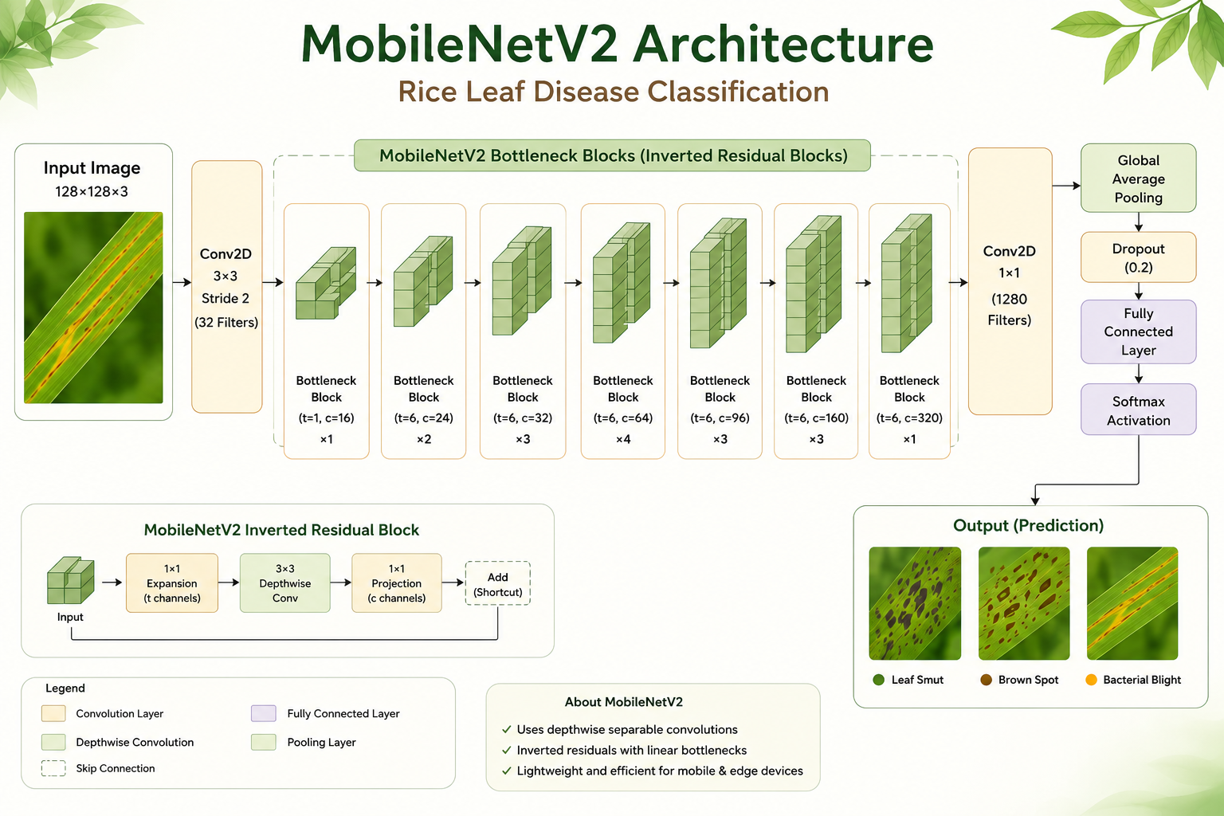
14. BEST MODEL
MobileNetV2
1.Reasons
Highest overall performance
Lightweight architecture
Fast inference
Lower memory usage
Suitable for mobile deployment
Better generalization on small datasets

Slide 17

15. APPLICATIONS
1.Real-World Applications
Smart farming
Mobile disease detection app
Agricultural decision support systems
Early disease diagnosis
Precision agriculture
Crop monitoring

Slide 18
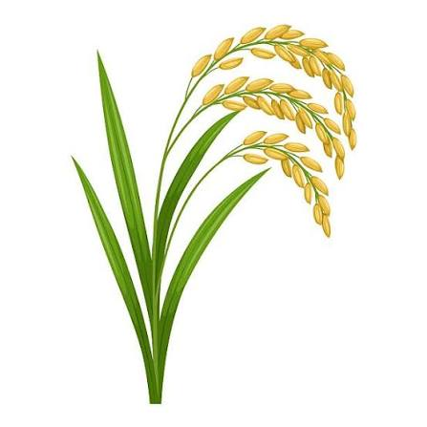
16. FUTURE SCOPE
1.Future Improvements
Collect larger real-world datasets
Include more rice diseases
Fine-tune pretrained models
Deploy as a web application
Develop Android/iOS application
Integrate real-time camera prediction
Cloud-based disease monitoring

Slide 19
17. CONCLUSION
Conclusion
Successfully developed a deep learning system for rice leaf disease classification.
Performed data preprocessing, augmentation, and exploratory data analysis.
Built and compared three deep learning models.
MobileNetV2 achieved the best balance of accuracy, speed, and model size.
Transfer learning significantly improved performance on the small dataset.
The proposed solution can support faster and more accurate disease
detection in precision agriculture.

Slide 20
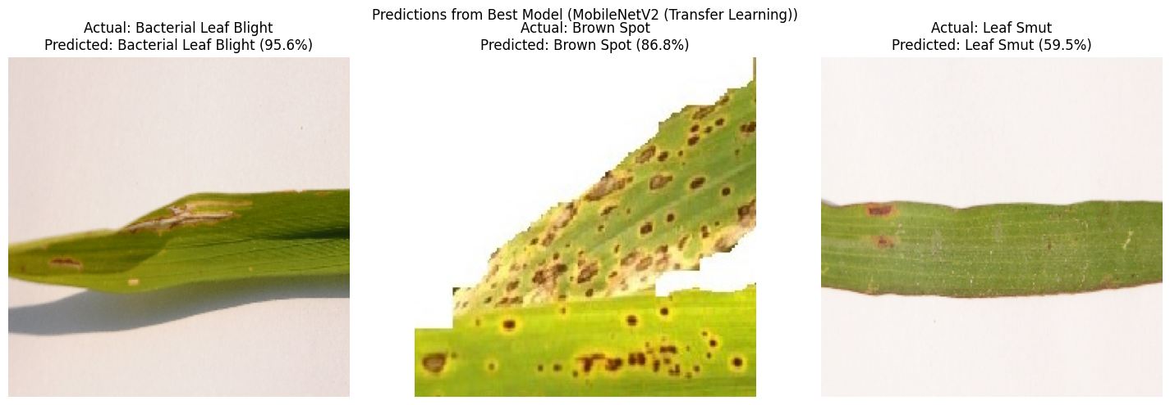
18.MODEL OUTPUT & PREDICTIONS

Slide 21
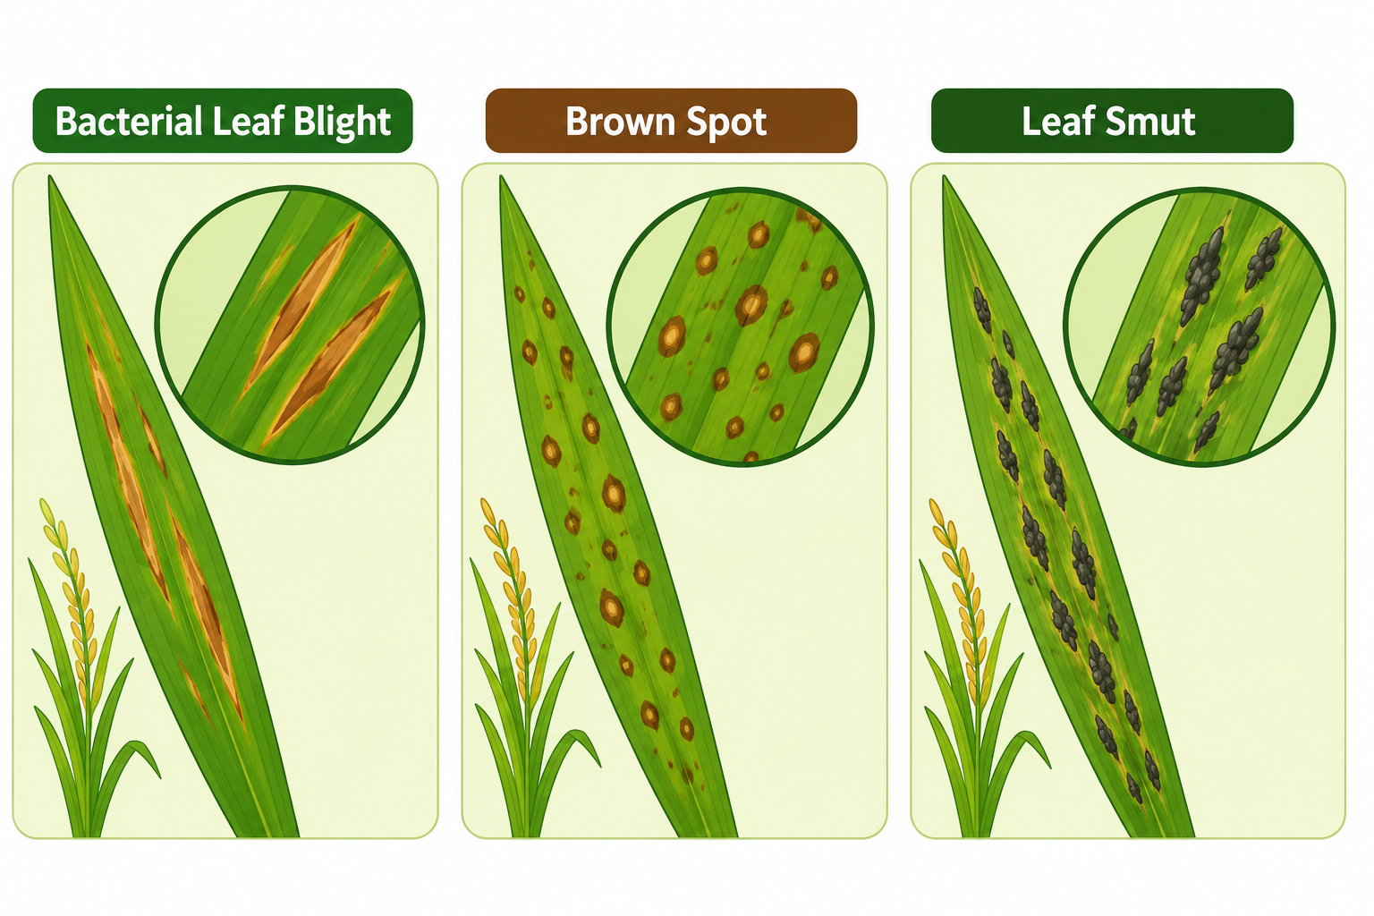
THANK YOU!!

